Slide 1
COVID-19 and Air Pollution
Namitha Anandaram Misha Berkowitz Orlando Godinez Garcia

Slide 2

Overview
Motivation and Summary
Questions and Data
Data Cleanup & Exploration
Data Analysis
Post-Mortem
Questions

Slide 3
Motivation and Summary
All of us are inundated with information about the pandemic
Most of it is scary… but there may be a silver (or green) lining
We are also learning about positive trends in our planet’s health
Our project focused on: How can we quantify whether air quality improves after restrictions to human movement are put into place?

Slide 4
Questions and Data
Question #1: Does air quality improve after restrictions begin?
Question #2: Does air quality continue to improve?
Question #3: What can we learn by grouping the data geographically?

Slide 5
Questions and Data, continued
An early decision point was where to look: globally or U.S. only?
High-level air quality data available for 66 countries via GitHub
https://github.com/mayukh18/covidexplore
Historical & current air quality data available for U.S. via APIs
https://aqs.epa.gov/aqsweb/documents/data_api.html
https://docs.airnowapi.org/
Decision: use the global air quality data available as .csv in GitHub

Slide 6
Questions and Data, continued
Another decision point was defining when restrictions began
Tracking restrictions with the same granularity as air quality (i.e., one data point per country) was challenging because:
As in U.S., global restrictions often apply at local/regional levels rather than at the national level
Different kinds of restrictions exist (total lockdown, SIP, voluntary)
Orders overlap and change frequently
We were unable to find a central repository of restriction data
Decisions: first research each country, then cross-check with Wikipedia

Slide 7


Data Cleanup & Exploration
Namitha found an article and underlying data set on GitHub containing a .csv of two metrics per country per week, starting 1/1/2020
Orlando LinkedIn stalked tracked down the GitHub user who posted the data and asked about his project and potential updates

Slide 8
Data Cleanup & Exploration, continued
As a group, we decided to rescope from the initial list of 66 countries to focus on the 44 countries with sufficient pollution data to analyze
NO2: Nitrogen dioxide
PM2.5: Particulate matter

Slide 9
Data Cleanup & Exploration, continued
Something that complicated our analysis is that most countries only started imposing restrictions in mid-March #1stWorldBootCampProblems
Therefore, we had little post-restrictions data to analyze:
Number of Countries with Pollution Data (for NO2, PM2.5, or both) …
… before restrictions | at least 1 week after | at least 2 weeks after | at least 3 weeks after | at least 4 weeks after
44 | 42* out of 44 | 29 out of 44 | 11 out of 44 | 5 out of 44
* Vietnam and Russia’s restrictions began Week 13 (March 23 – 29)

Slide 10
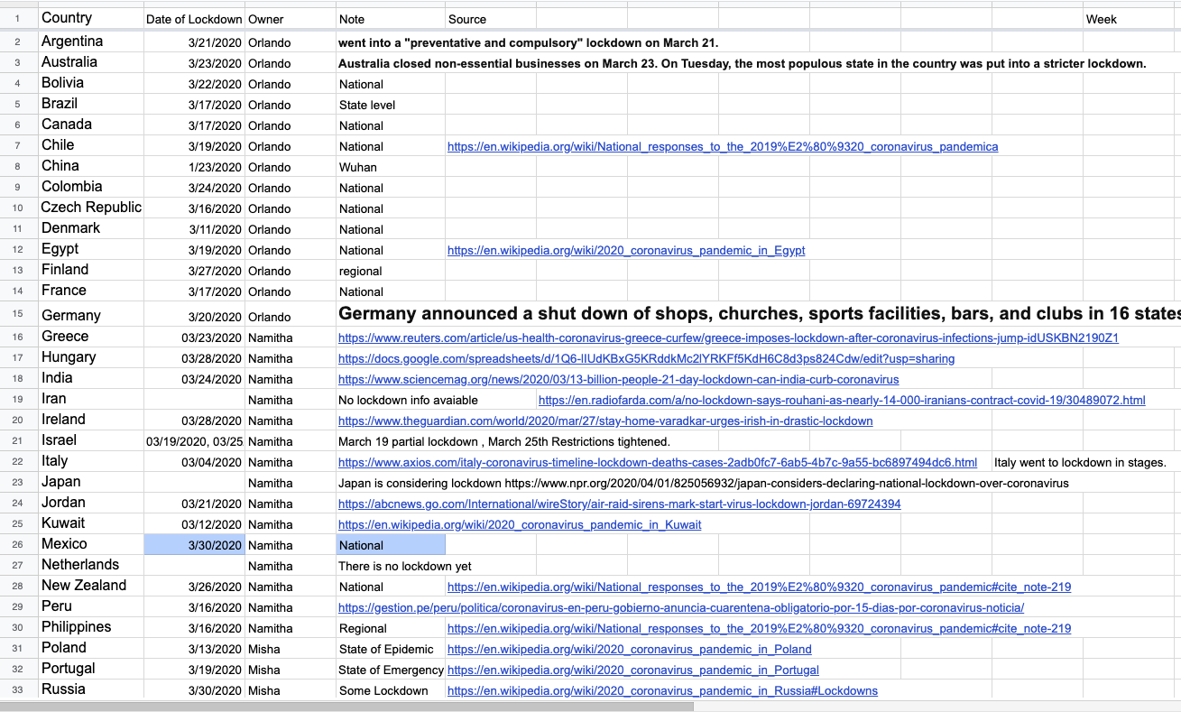
Data Cleanup & Exploration, continued
We researched and compiled restriction data in a Google doc
Realizing an apples-to-apples comparison across countries might be inconclusive, we included info from Wikipedia to add context for further study
After a little hands on data cleanup in Excel, we were ready to plot a course for Jupyter
BEFORE
AFTER

Slide 11
Data Cleanup & Exploration, continued
Misha set up code that imported and merged our pollution and restrictions data into a single DataFrame:
Additional code added columns to track:
“Restrictions”: whether each row was a “Restriction” week (Yes or No)
“Restriction Week Counter”: how many weeks into restrictions is this country

Slide 12
Data Cleanup & Exploration, continued
The resulting DataFrame was outputted as a .csv
We decided to create a separate Jupyter file for each question
We will now discuss the data and visualizations

Slide 13
Data Analysis - Question #1: Does air quality improve after restrictions begin?
Findings:
Iran had the highest pre-restriction emissions data of all 44 countries studied, followed by Israel and South Korea
On the other end was New Zealand
New Zealand, Ireland, and United Kingdom did not show any change before or after restriction
Meanwhile, things seemed to get worse in Mexico
Air quality improved across the board for all other countries

Slide 14
Data Analysis - Question #1, continued
NO2, before and after restrictions

Slide 15
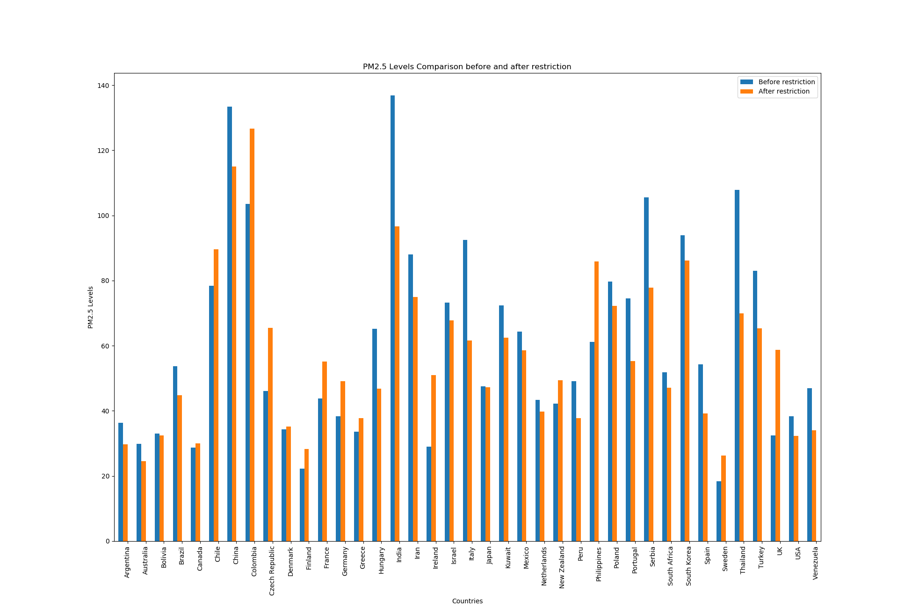
Data Analysis - Question #1, continued
PM2.5, before and after restrictions

Slide 16
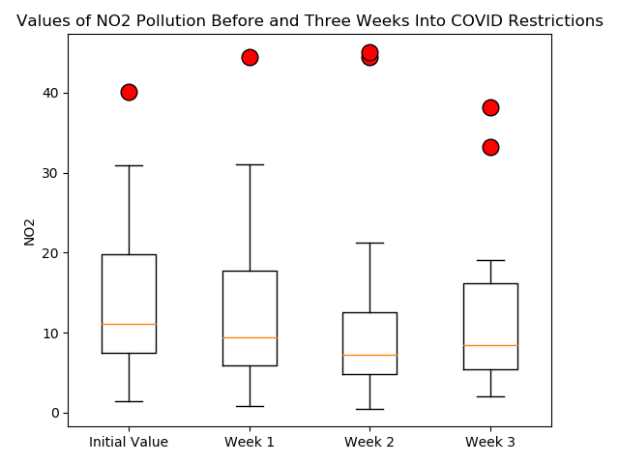
Data Analysis - Question #2: Does air quality continue to improve?

Slide 17
Data Analysis - Question #2, continued
Findings:
NO2 decreased in the first two weeks following restrictions
At first glance, that trend not appear to continue into Week 3
However, upon closer inspection, some of the countries where emissions were lowest (New Zealand, United Kingdom) did not impose restrictions early enough to have data in Week 3
Additionally, Iran and South Korea (the outlier points) were disproportionately affecting the whole data set due to the overall lower number of data points in later weeks

Slide 18
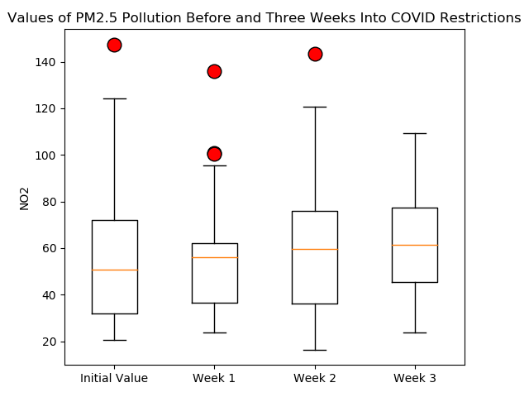
Data Analysis - Question #2, continued

Slide 19
Data Analysis - Question #2, continued
Findings:
PM2.5 did not seem to follow any particular pattern following restrictions when studied as a week-to-week population
It is possible that we would see a clearer trend emerge with more data

Slide 20

Data Analysis - Question #3: What can we learn by grouping the data geographically?
Findings
We looked at the average emissions data before and after restrictions, and grouped the results by continent
We wondered if we might be able to detect a regional level of industrialization by seeing a decrease in one continent or another
It’s not clear that we learned anything

Slide 21
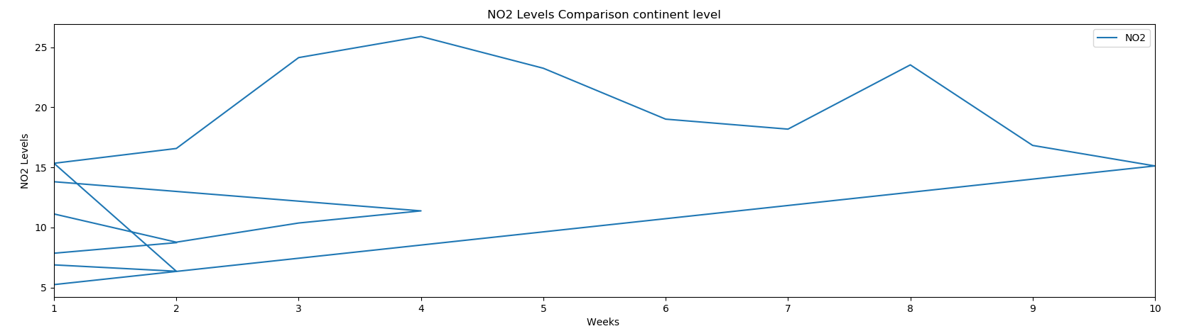
Data Analysis – Question #3, continued
NO2, before and after restrictions:

Slide 22
Post Mortem: Challenges
Challenges:
Honing questions so they could be studied quantitatively
Reducing scope so we could get … something… done
Standardizing our data so we could perform analysis
Getting data into the proper format for visualization
Organizing our resources (time, files, brainpower) so we could collaborate effectively and incorporate new data/ideas while still accomplishing the project

Slide 23
Post Mortem: Opportunities
Opportunities for further study:
Studying relative emission data rather than absolute data:
How did countries’ emissions change proportionally week-to-week?
How well could we predict Week 4 data for a country given its first three weeks of data following restrictions?
Is there any relationship between the level (e.g., National, Regional) of restrictions and resulting emissions change?

Slide 24
Questions?

